Slide 1
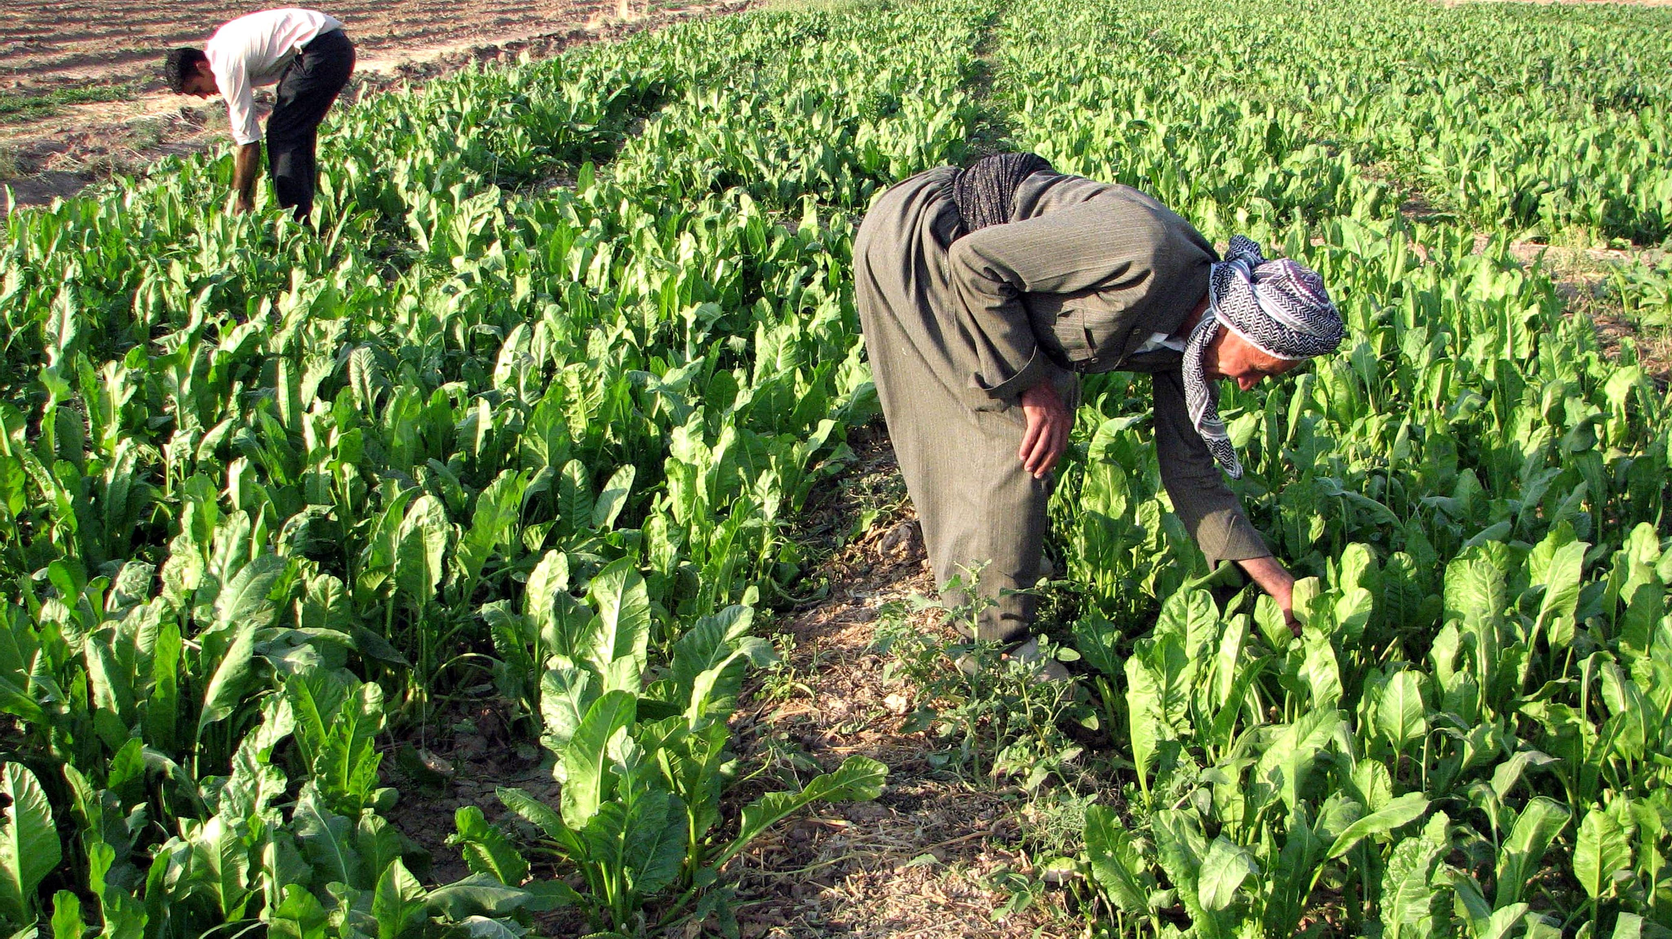
FARMER'S FRIEND
An initiative to help farmers

Slide 2
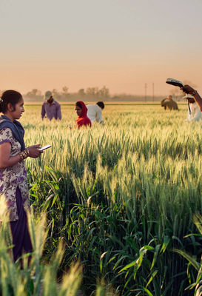
Why Farmer's Friend ?
The selection of crops can be a bit chaotic for some farmers. Temperature and rainfall changes are expected to significantly have negative impact on wide range of agricultural activities for the next few decades. With the changing of climate, agriculture faces increasing problems with extreme weather events leading to considerable yield losses of crops.
Hence we present you the Farmer's Friend. The program has a simple interface and takes information on three parameters- weather, soil type and crop type from the farmer according to his priorities and provides information about the best suitable crop to his priorities.

Slide 3
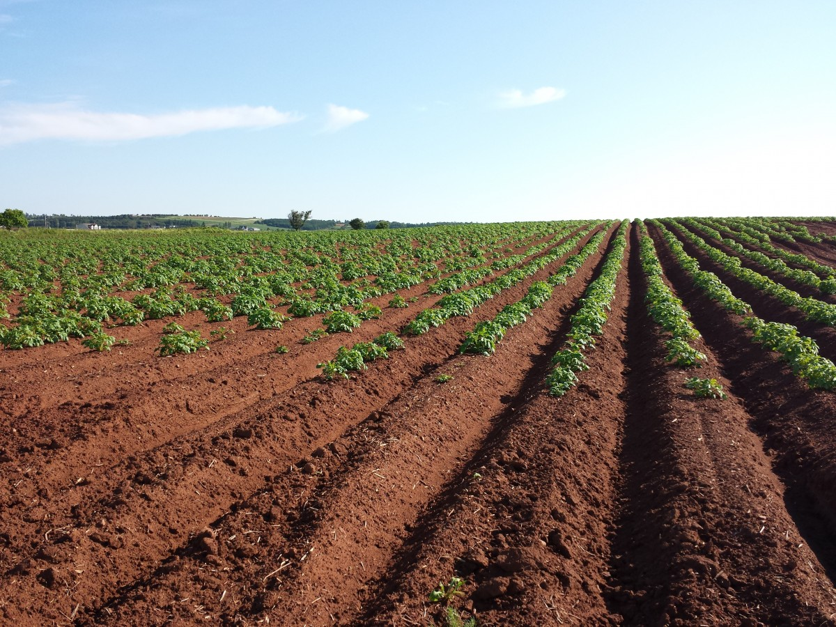
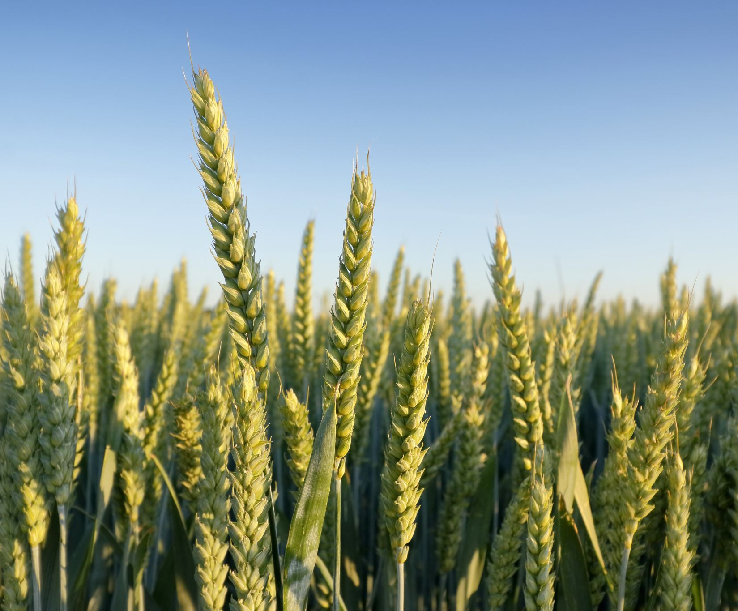
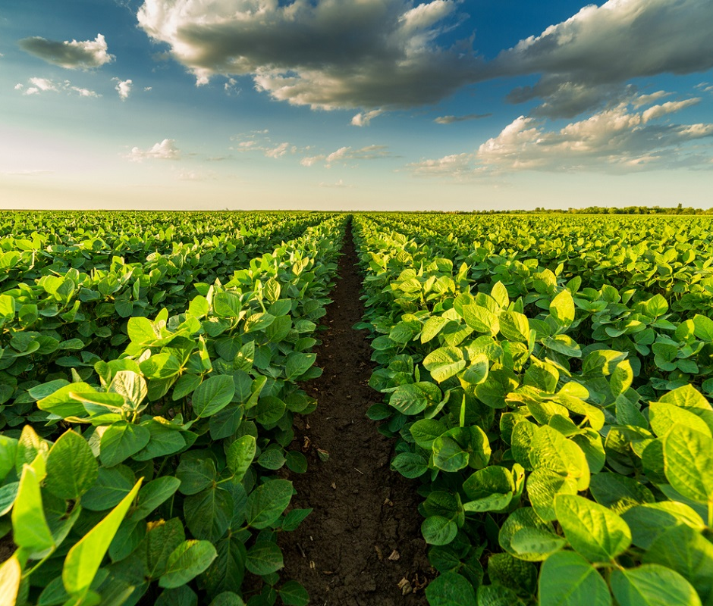
SOIL TYPE
SEASON TYPE
CROP TYPE
Clayey
Loamy
Red
Black
Clayey-Loam
Sandy-Loam
Alluvial
Laterite
Rabi
Kharif
Zaid
Food crop
Cash crop

Slide 4
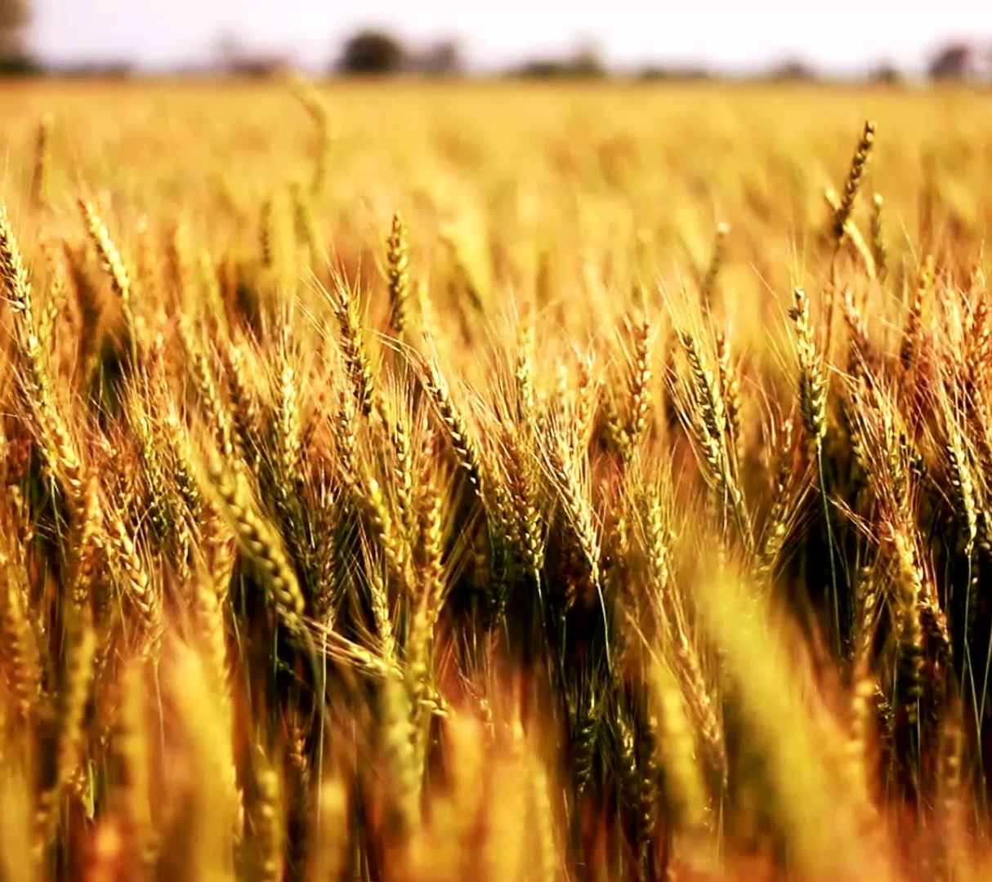
CROPS
Rice
Wheat
Tea
Sugar cane
Cotton
Tobacco-biddi
Tobacco-cheroot
Tobacco-FCV
Tobacco-Hokka
Jute
Jowar
Rubber

Slide 5
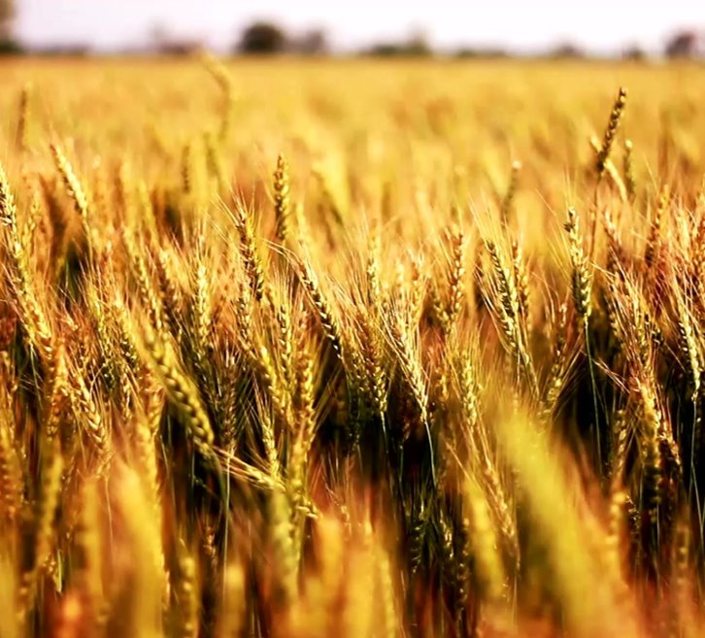
CROPS
Ragi
Bajra
Coffee
Mustard
Sunflower
Groundnut
Bengal gram
Arhar
Moong
Masoor

Slide 6
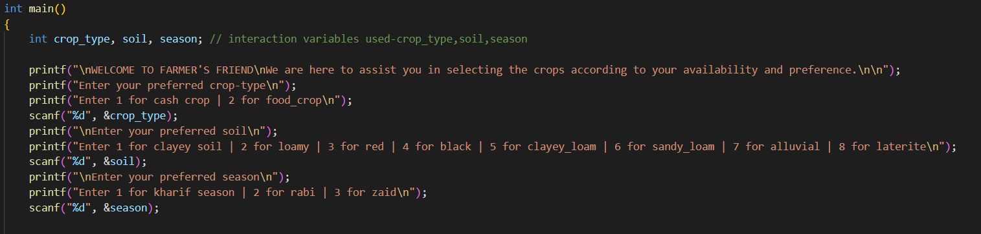
Code Breakdown
First we take the input from the user

Slide 7
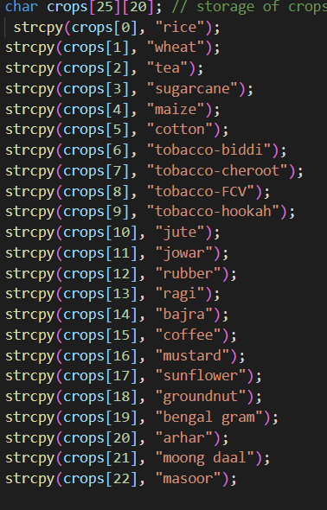
Storing the crops in an array

Slide 8
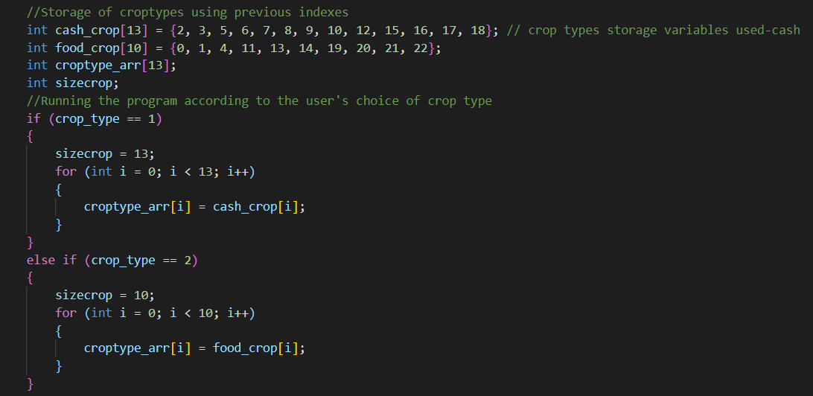
Taking index as the reference, storing the values in crop-type array

Slide 9
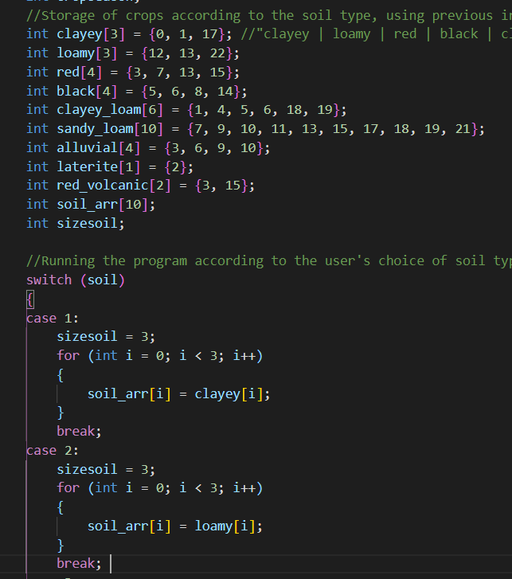
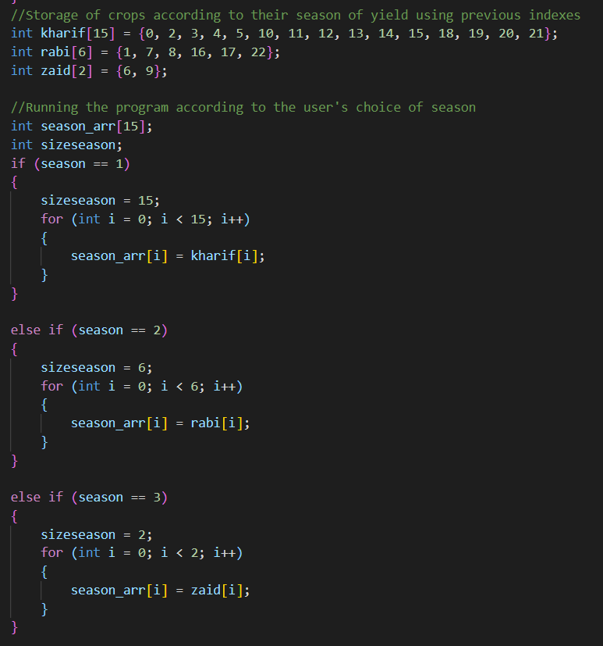
Storing the value in soil-type and season-type array

Slide 10
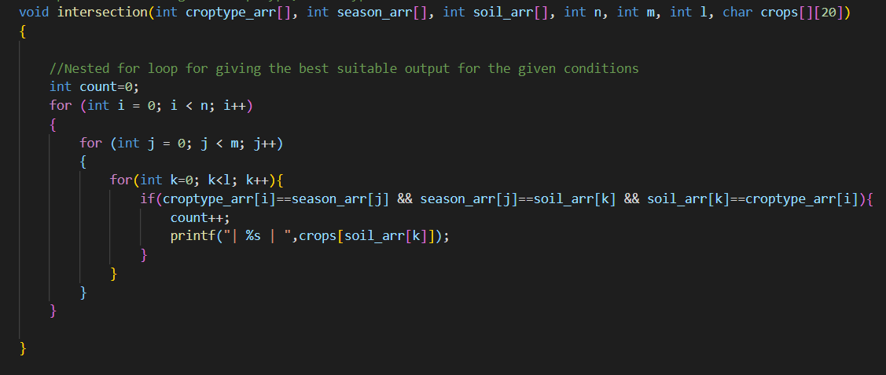
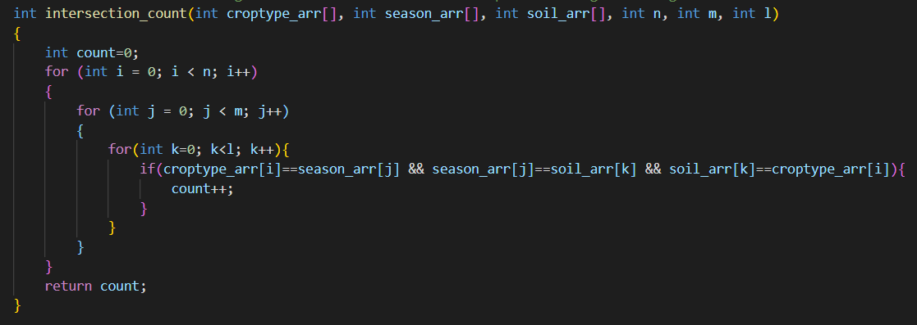
Calling the function intersection to find the best suitable crop satisfying all three parameters
Calling the function intersection_count to get the no. of crops that satisfy user preference

Slide 11
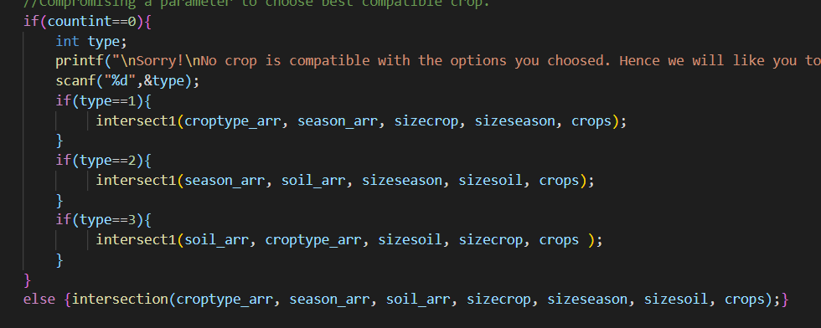
Case when the value of count is zero

Slide 12
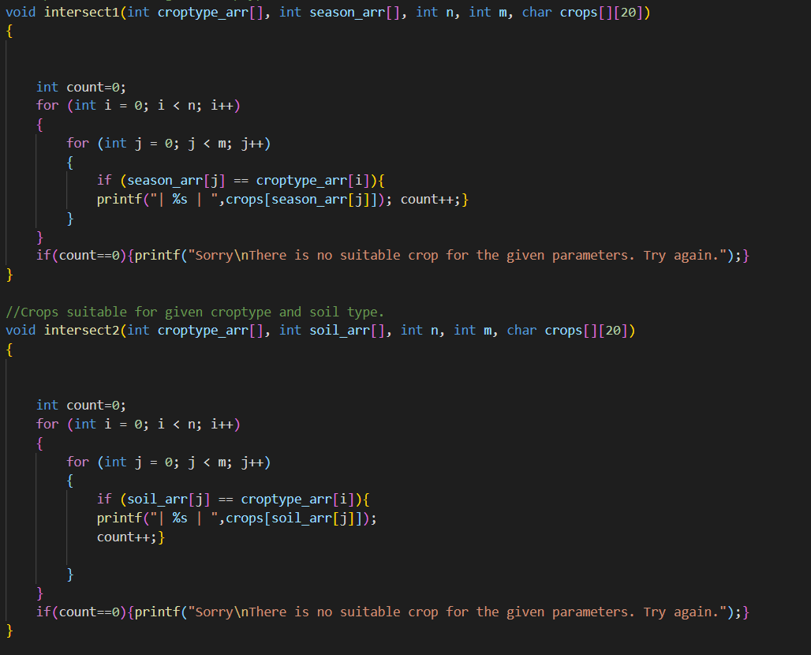
Calling different intersection function, now using only 2 parameters to get the desirable output

Slide 13
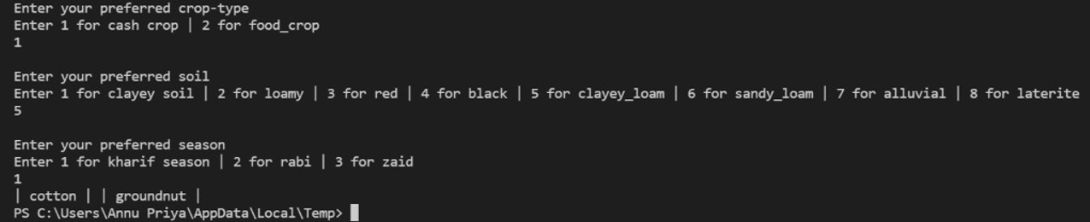
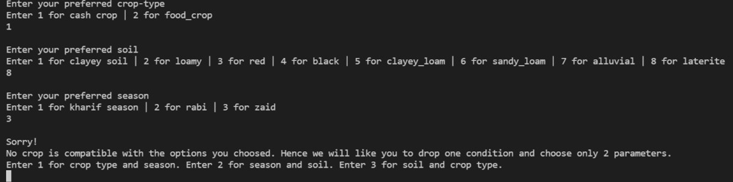
Output showing the crops that satisfied all 3 parameters
When no crop satisfied all 3 parameters

Slide 14
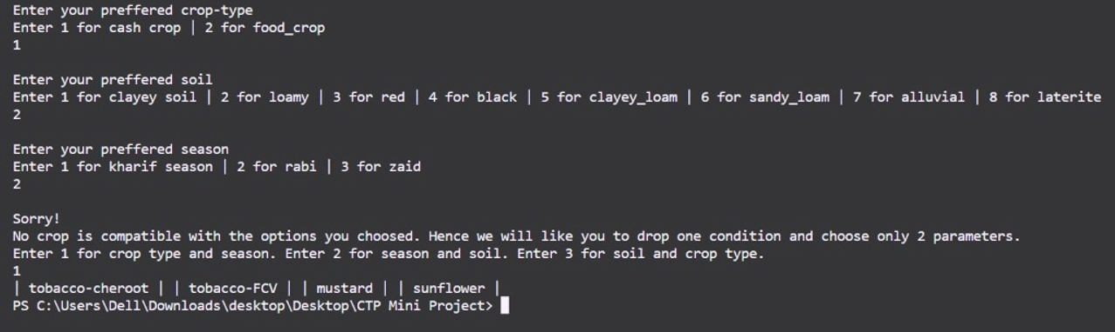
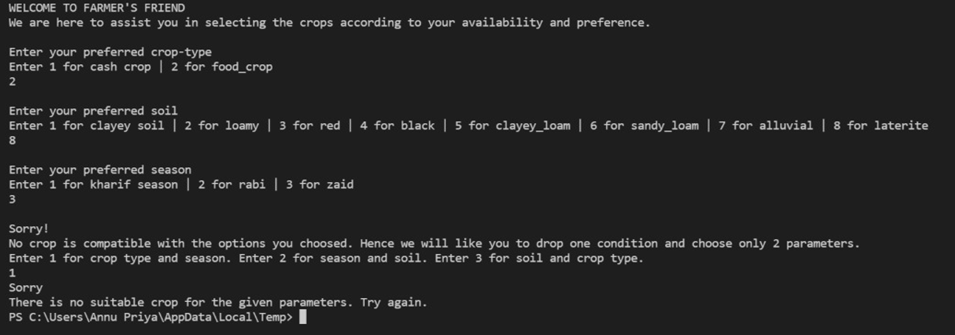
Outputs obtained by dropping one of the parameters

Slide 15
THANK YOU
Contributed By -:
Annu Priya
Greeshma
Jitendra
Shivi Gupta

